Slide 1
上海卡垣电子科技有限公司限公司
Shanghai Jiayuan Electronic Technology Co., LTD
公司介绍

Slide 2
01 .
企业简介
创新引领未来
02 .
产品概述
目 录
CONTENTS
A dream need to work out a summary report dream need to work out a need out a summary report summaryA dream need to work
03 .
应用场景
04 .
我们的优势

Slide 3
企业简介
01
Enterprise brief introduction
核心价值
企业精神
企业理念
企业历程

Slide 4
企业简介
Company profile
上海卡垣电子科技有限公司
Shanghai Jiayuan Electronic Technology Co., LTD
2008年，PAKU（帕库）在中国上海成立组装工厂，上海嘉图自动化控制系统有限公司（拥CATO卡托自主品牌 http://www.cato-sh.com）及旗下公司上海卡垣电子科技有限公司均为德国PAKU（帕库）国内特供元器件组装工厂。目前占中国市场独家领域，全套采用德国PAKU（帕库）工厂先进技术和制造工艺。
In 2008, PAKU set up an assembly plant in Shanghai, China. Shanghai Jiatu Automation Control System Co., LTD. (with CATO's own brand http://www.cato-sh.com) and its subsidiary Shanghai Kayuan Electronic Technology Co., LTD., are PAKU's national components assembly plants in Germany. At present, it occupies the exclusive market in China and adopts the advanced technology and manufacturing process from PAKU factory in Germany.

Slide 5
企业简介
Company profile
核心价值
态度：正确和积极态度
协作：人心齐、泰山移
创新：突破常规、即突破旧的思维定势
坚韧：精诚所至、金石为开
Attitude: Correct and positive attitude
Cooperation: unity of heart, Taishan shift
Innovation: break through the conventional, that is, break through the old mindset
Tenacity: faith will move mountains

Slide 6
企业简介
Company profile
企业精神
至真至诚 至信至远
True and sincere to the letter far
企业理念
本公司秉承“科技、质量、诚信、服务”的宗旨，为全国各地的用户现场提供优质的系统化解决方案。
The company adhering to the "science and technology, quality, integrity, service," the purpose, for users throughout the country to provide quality on-site systematic solutions.

Slide 7
企业历程
Business process
2012
2018
2017
2008
2020
2015
2019
在上海成立
组装工厂
Established in Shanghai
Assembly plant
全国多地成立分销点
Distribution points have been set up in many places throughout the country
占领中国市场独家领域
Occupy the exclusive territory of the Chinese market
取得管理体
系认证书
Acquisition management body
Department of certification
拥有行业尖端客户三一重工、北京中电华强、三峡水电等
Sany Heavy Industry co., LTD., Beijing Zhongdian Huaqiang Co., LTD., Three Gorges Hydropower Co., LTD
快速发展，规模进一步扩大
Rapid development, further expansion of scale
参加全国各地展会
Participate in exhibitions all over the country

Slide 8
产品介绍
02
Product introduction
流量系列
压力系列
温度系列
压力系列

Slide 9
产品介绍
Product introduction
流量系列
Flow series
压力系列
Pressure series
压力系列
Pressure series
液位系列
Liquid level series

Slide 10
流量主推款Traffic main push
涡轮流量传感器SN51
微小圆形齿轮流量传感器SN54B
涡轮流量传感器是一种精密流量测量仪表，适用于测量 低粘度的介质， 如水、柴油、汽油等。
Turbine flow sensor is a precision flow measurement instrument, suitable for measuring low viscosity media, such as water, diesel oil, gasoline and so on.
通过高精度齿轮容积计算介质通过体积，达到微小流体介质测量。是一种新型的容积式流量传感器。适用多种介质。
Through high precision gear volume calculation medium through volume, to achieve micro fluid medium measurement. It is a new volumetric flow sensor. Suitable for a variety of media.
智能涡街传感器SN53B
电子式流量开关SN10B
基于卡门涡街原理，另采用高精度传感器进行温度测量， 可任意设置温度上下限报警值， 可远程监控实时温度状况， 全参数现场任意设置。
Based on the Principle of Karman vortex street, the high precision sensor is used for temperature measurement, and the upper and lower alarm values of temperature can be set arbitrarily, the real-time temperature condition can be monitored remotely, and all parameters can be set arbitrarily on site
基纡热式原理，免维护，结构紧凑, LED显示流动趋势及开关状态。气液两用型，低流速报警，可用于气动和液压系统，可用于循。
Basic thermal principle, maintenance free, compact structure, LED shows flow trend and switching status. Gas-liquid dual type, low flow rate alarm, for pneumatic and hydraulic systems, can be used for circulation.

Slide 11
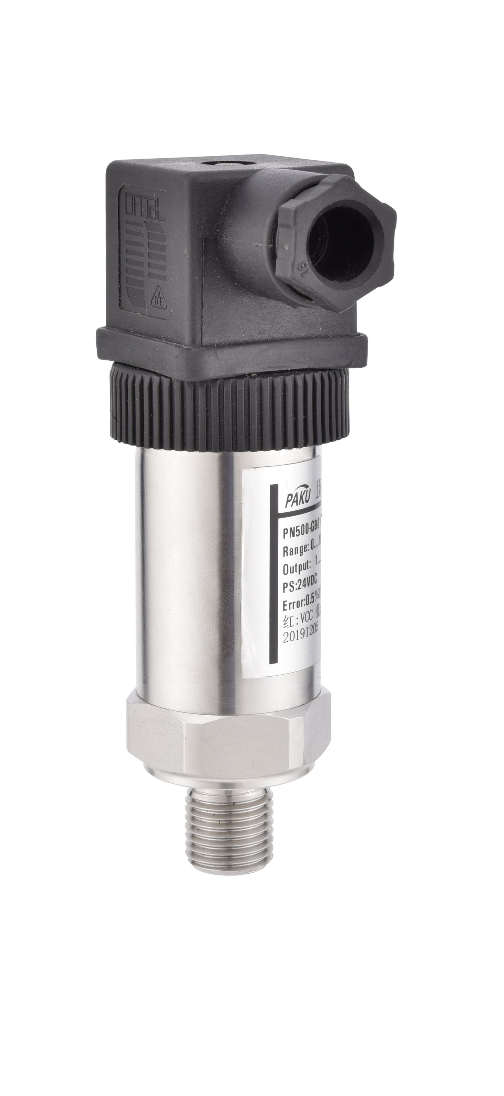
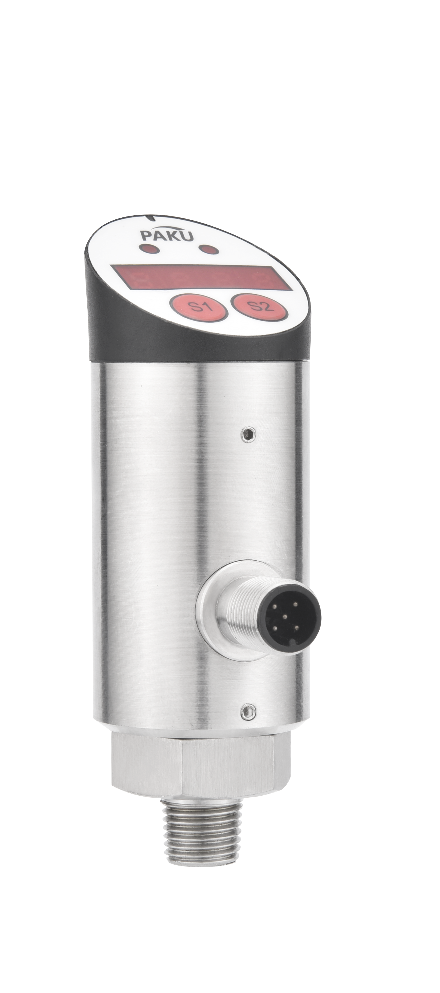
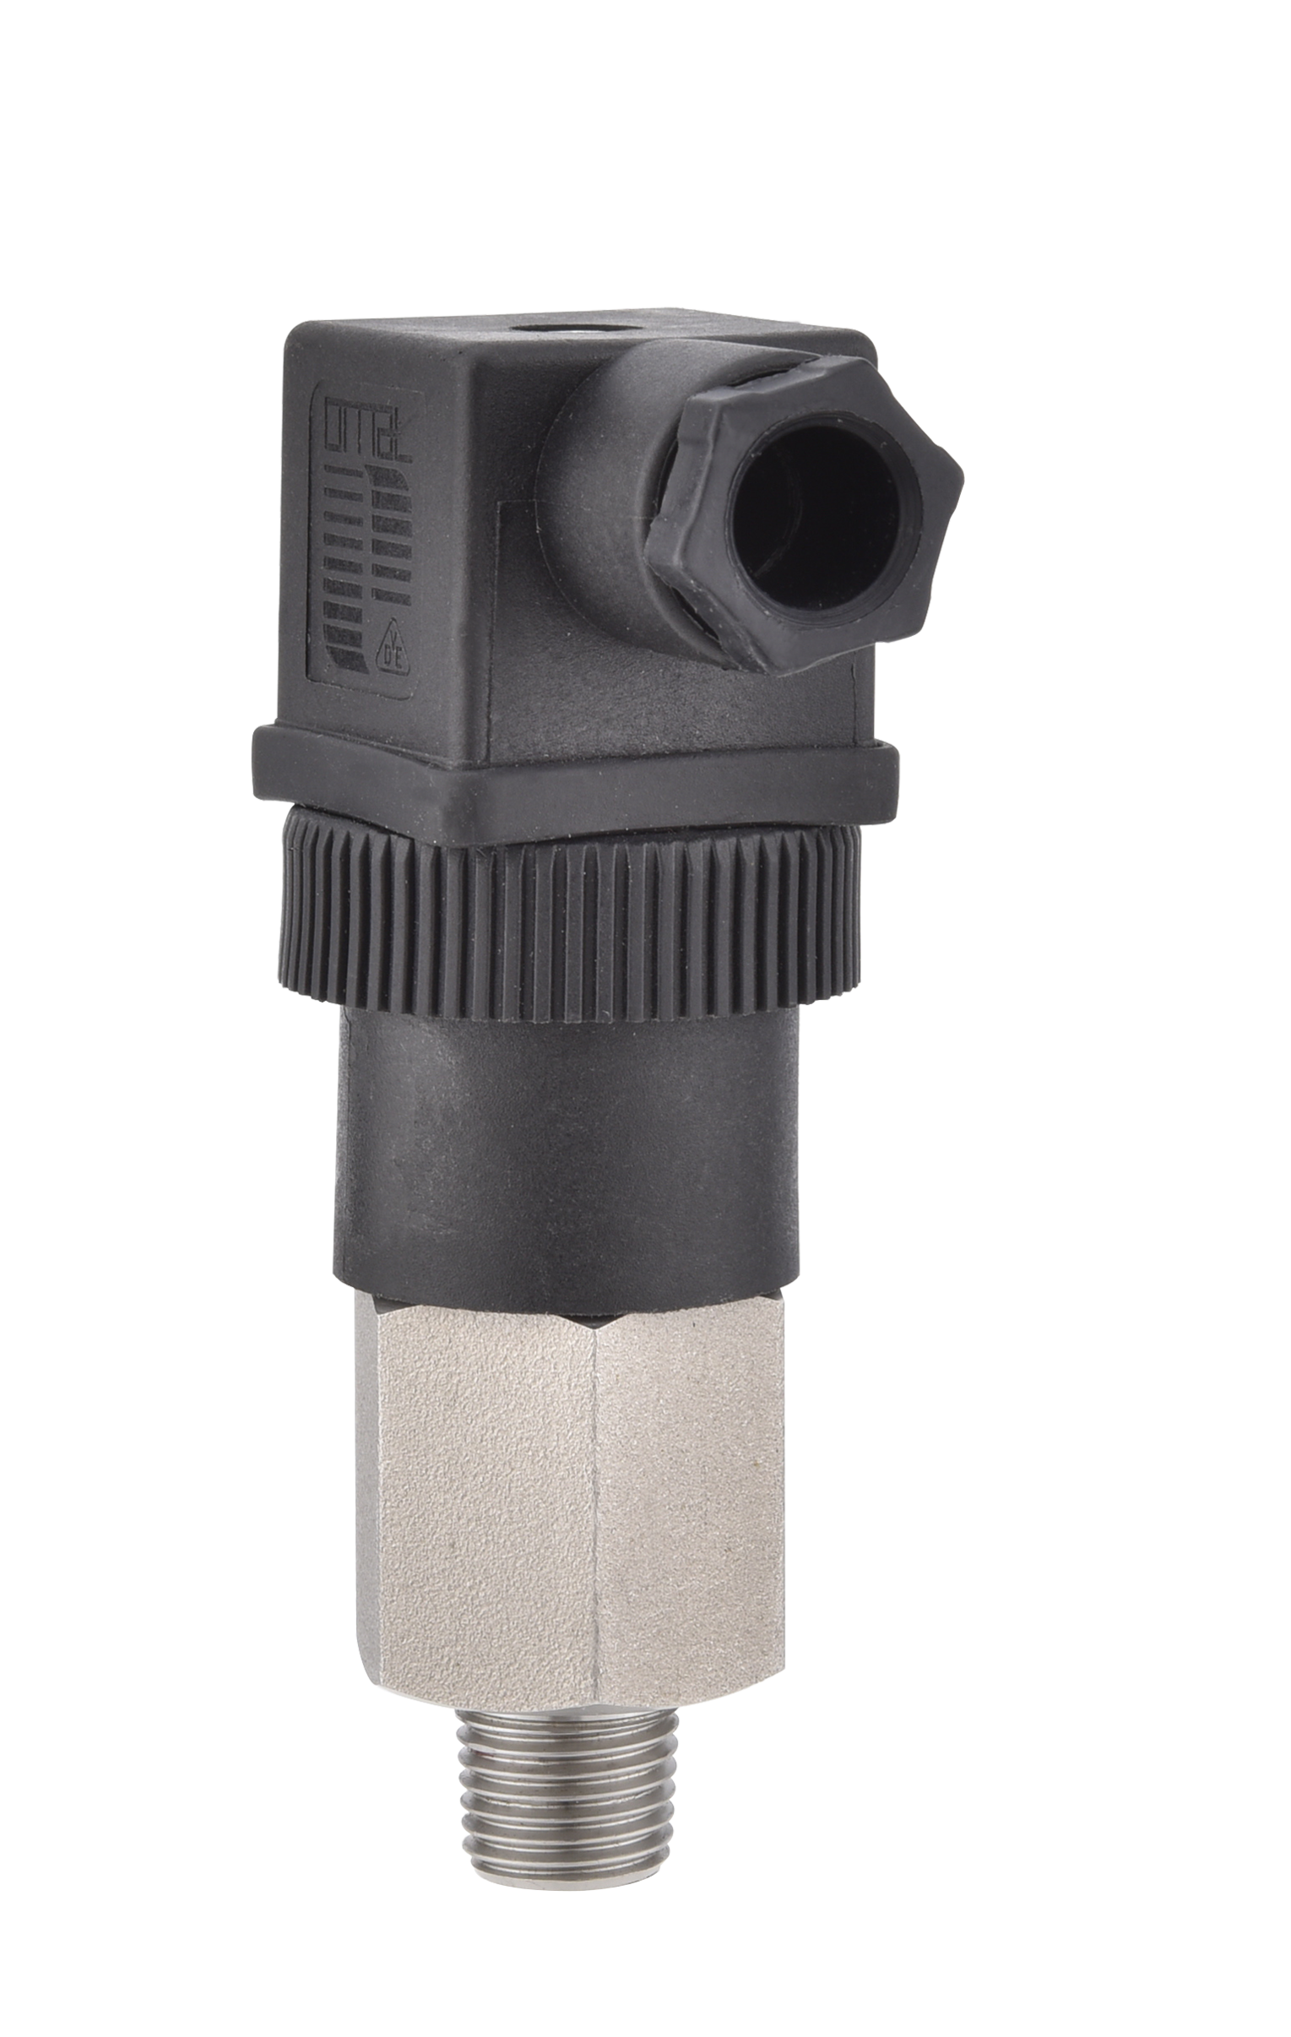
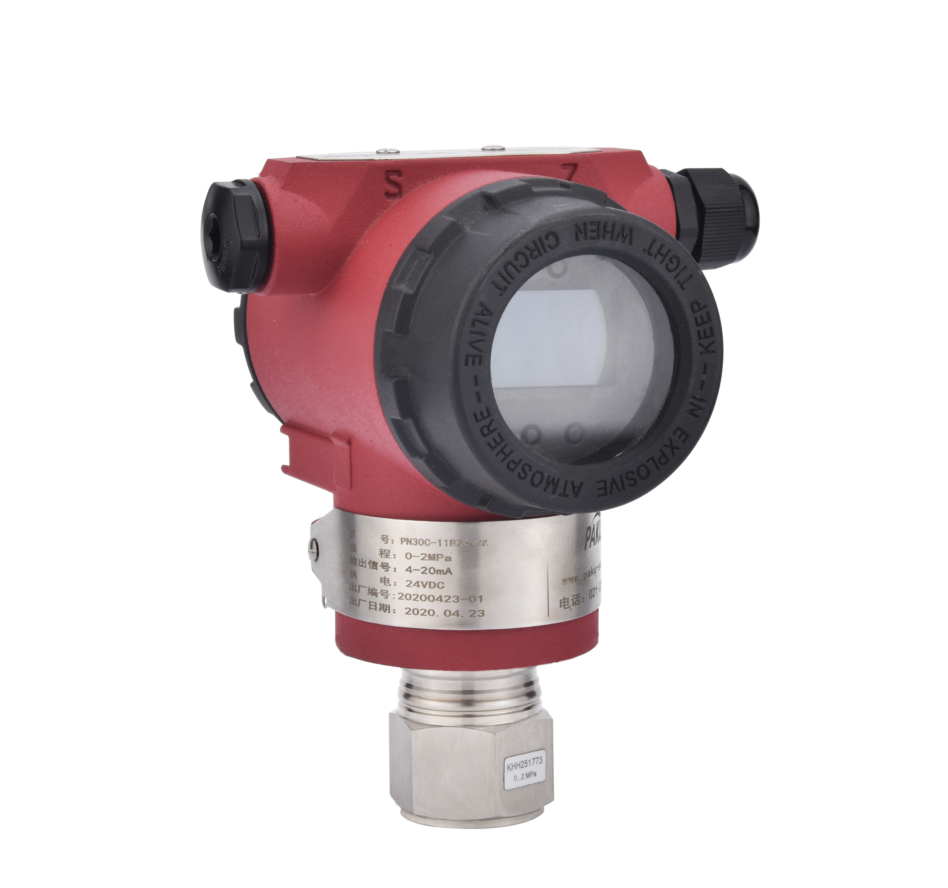
压力主推款Pressure is the main push
通用压力传感器PN500
电子数显压力开关PN80
机械可调压力开关P20
高精度单晶硅压力变送器PN30C
紧凑型扩散硅式压励变送器，选择宽广,结构紧凑，翻较恶劣环境，舸靠性
电子式压力传感器采用高精度扩散硅芯体，确保了传感器的高精度和耐用性。带有现场显示，LED 数字显示现场压力或设定菜单。
具有常开或常闭触点，接点镀金,触点容大。可于水、油、气体压力的测量。
单晶硅式压力变送器采用了全隔离电路技术设计，对电源和传感器信号进行隔离处理，提高了整机的稳定性和抗干扰能力。
Compact diffused silicon pressure excitation transmitter, wide selection, compact structure, turn over harsh environment, green boat.
Compact The electronic pressure sensor adopts high-precision diffused silicon core to ensure the sensor's high accuracy and durability. With field display, LED digital display field pressure or setting menu.
Compact The With normally open or normally closed contact, gold-plated contact, contact capacity. Can be used in water, oil, gas pressure measurement.
Monocrystalline silicon pressure transmitter adopts full isolation circuit technology to isolate the signals of power supply and sensor, which improves the stability and anti-interference ability of the whole machine.

Slide 12
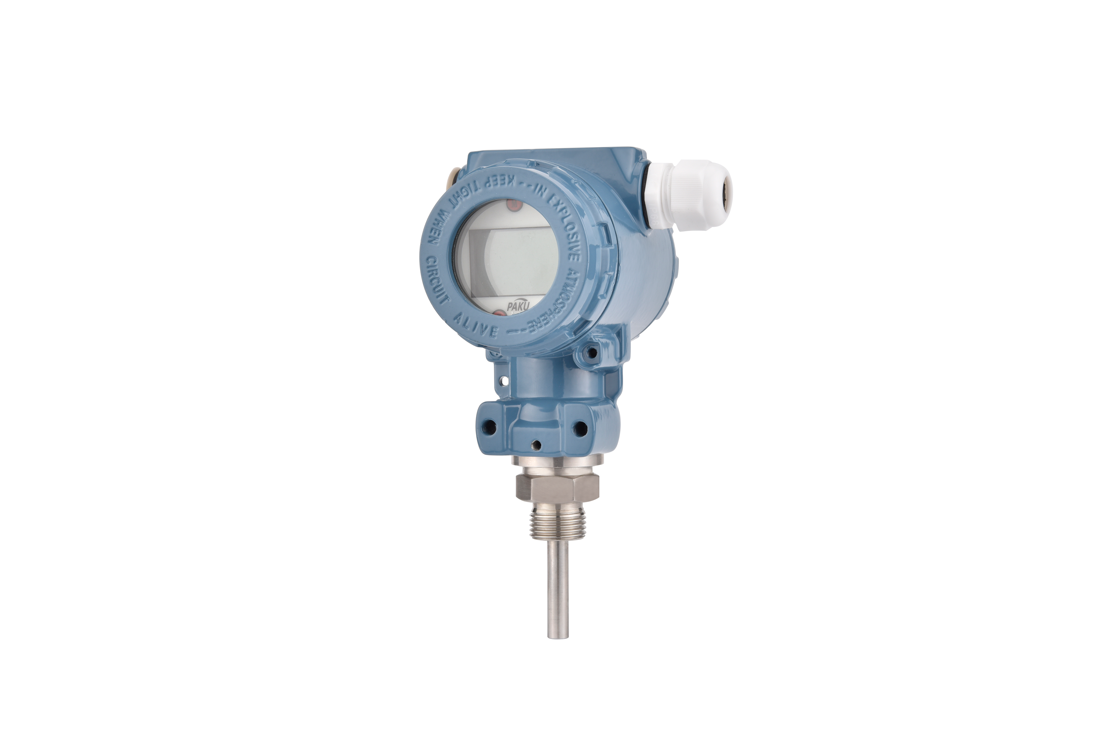
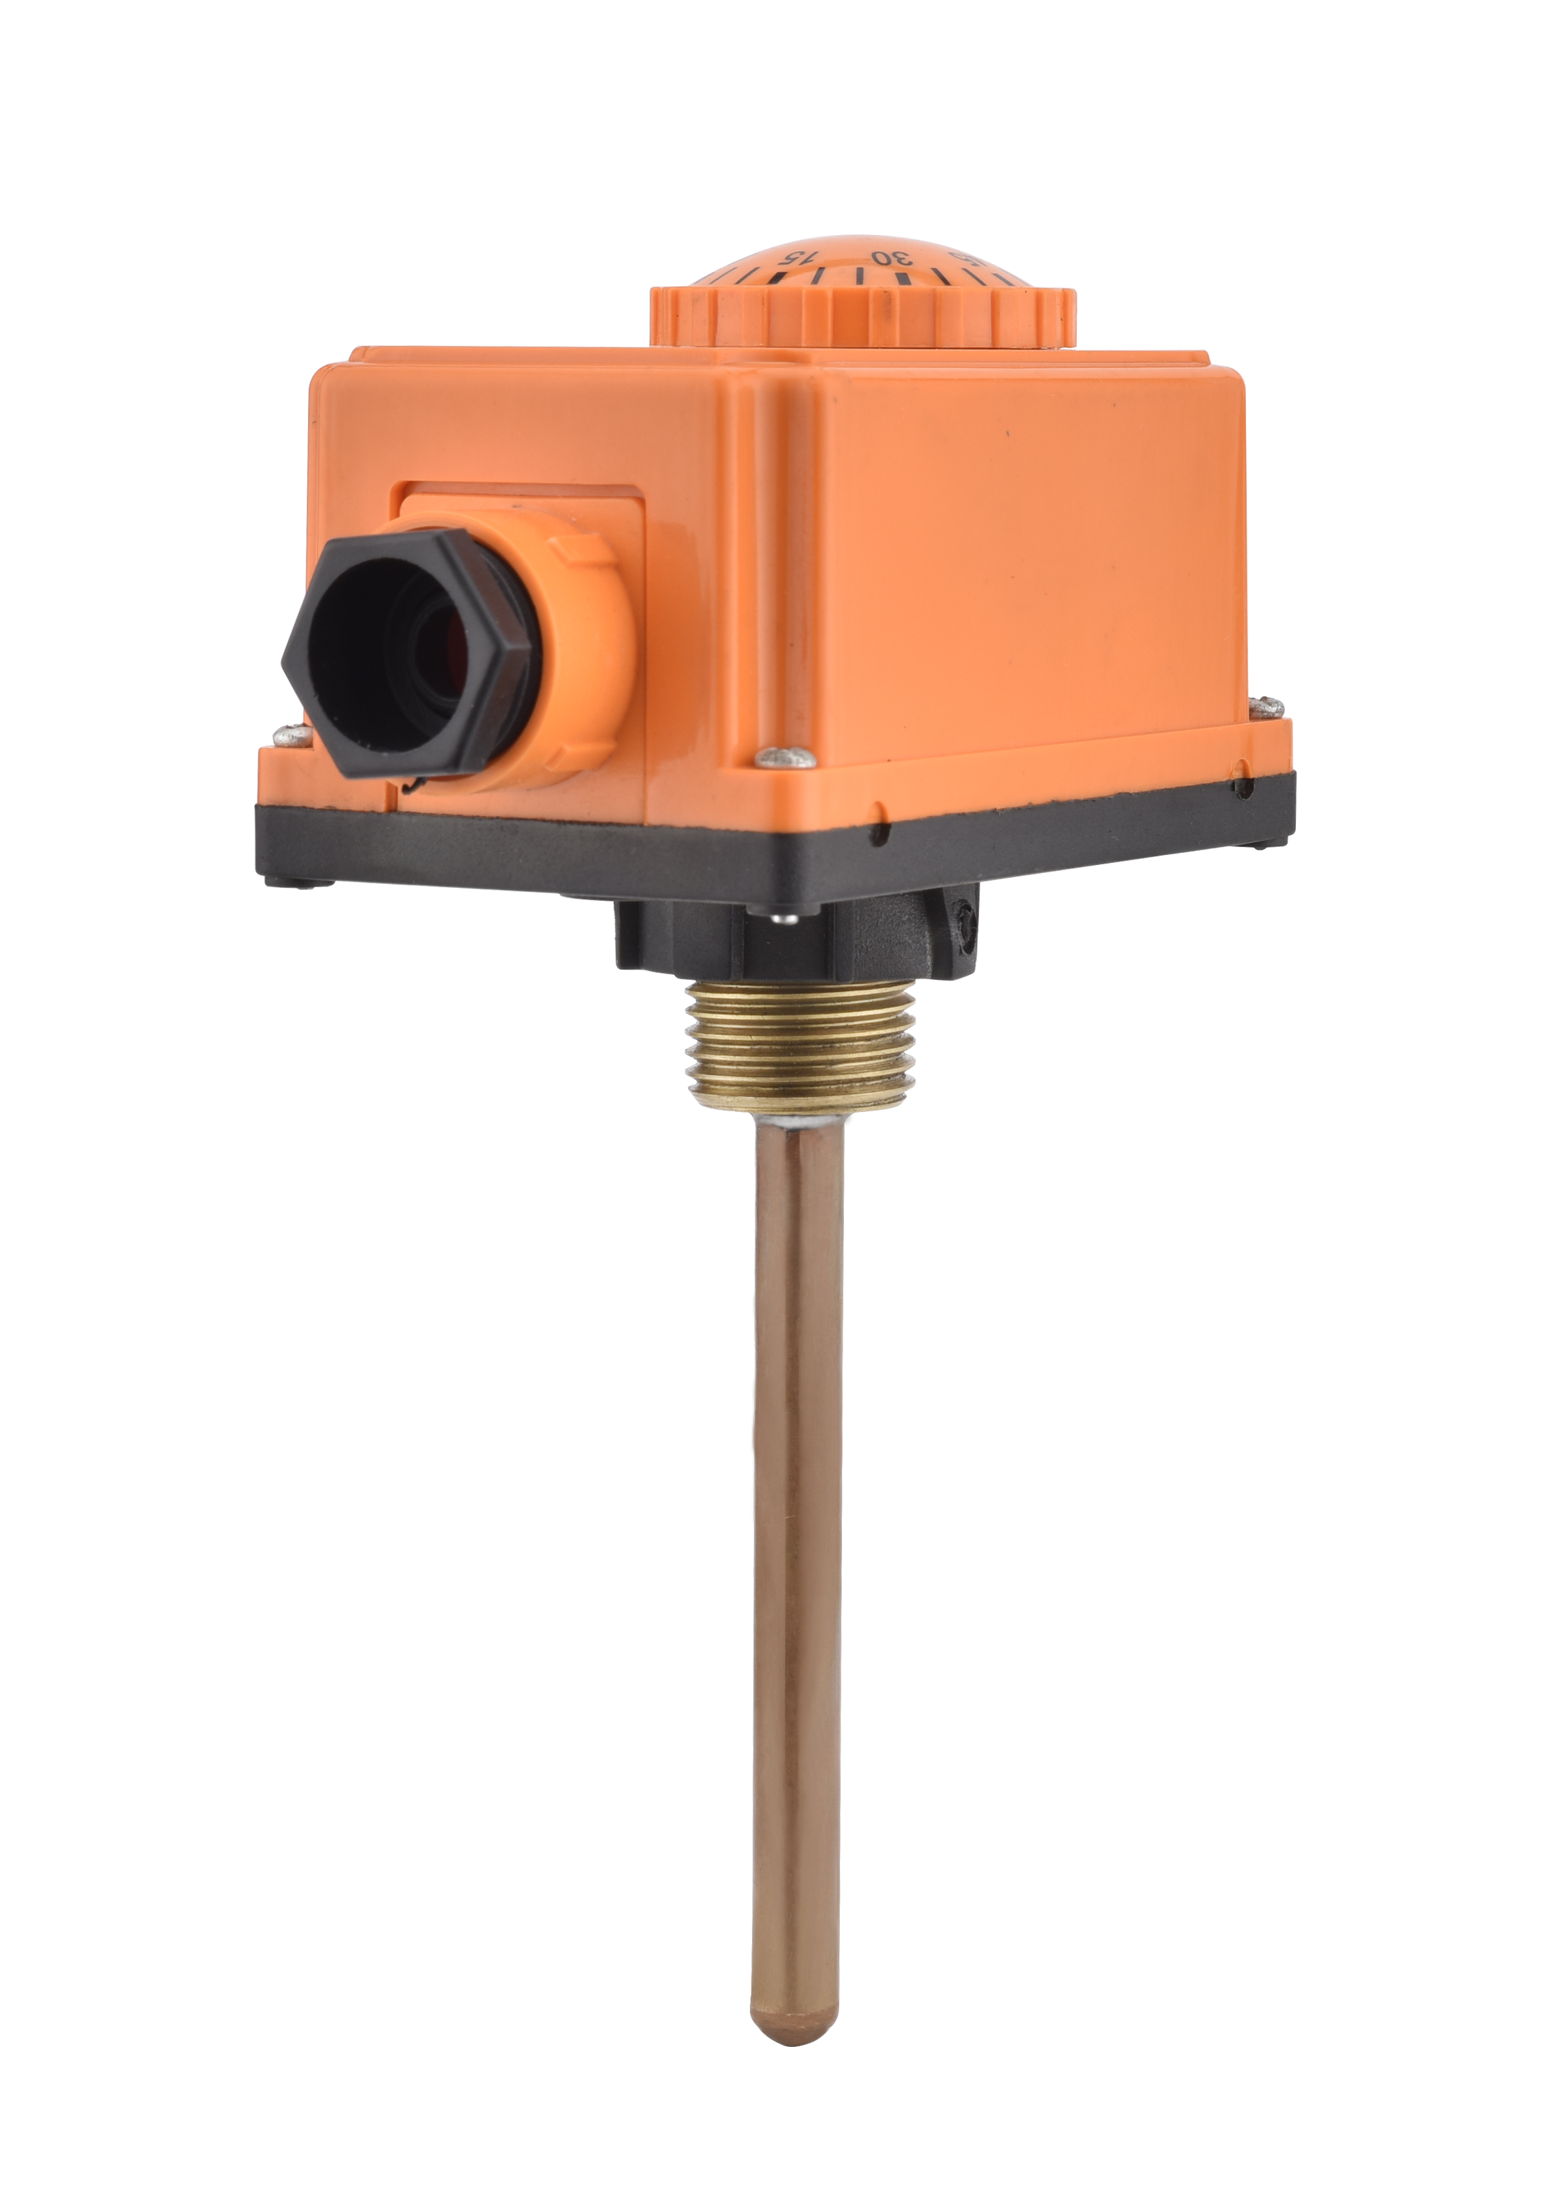
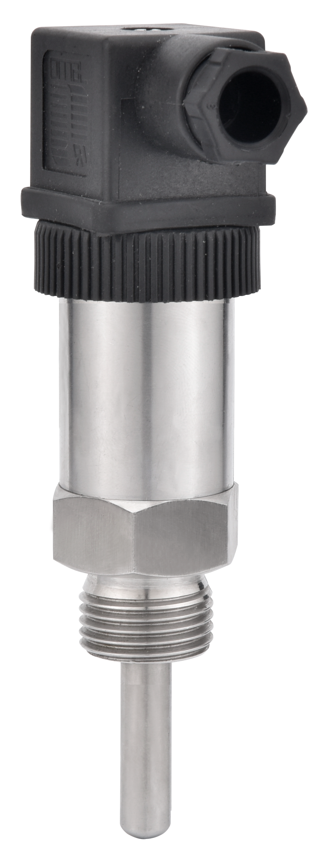
温度主推款Temperature main push
数显温度开关T850
一体式温度变送器T450
通用温度变送器T550
机械可调温度开关T200
采用高精度传感器进行温度测量，信号由后部处理电路处理后转换成标准I业电信号输出并显示
T450内部电路将其值转化成线性模拟量输出。多种量程可选，多种规格探头可选，钚锈钢外慨，结构紧凑坚固。
有较广测量范围的温度变送器，采用热点偶或PT100热电阻进行度测量。
当温度达到设定值时，绕制成环形弯曲状的双金尻-段受热膨胀触发内置装置 ,开关动作。
High precision sensor is used for temperature measurement, and the signal is processed by the rear processing circuit and converted into standard I electrical signal output and display
The T450 internal circuit converts its value to a linear analog output. A variety of measuring range, a variety of specifications of the probe is optional, plutonium rust steel, compact and strong structure。
Temperature transmitter with a wide measuring range, using hot spot couple or PT100 thermal resistance for degree measurement,
When the temperature reaches the set value, the double gold jiri - section is wound into an annular curve, which is heated and expanded to trigger the built-in device, and the switch operates.

Slide 13
液位主推款
Liquid level main push model
01
电子式液位开关传感器LF600
采用磁感应技术传感器进行液位测量，号诟部处理电路处理后转换成标准I业电信号输出并际。 Using magnetic induction technology sensor for liquid level measurement, no. Black part processing circuit after processing into standard I electrical signal output and parallel.
浮子式液温开关LF200
02
您浮球中装有环形磁环，浮球随液位的上升或下降而移动，从而触发或释放不锈钢管内的磁簧开关,发出开关信号。 The floating ball is equipped with a circular magnetic ring. The floating ball moves with the rise or fall of the liquid level, thus triggering or releasing the magnetic spring switch in the stainless steel tube and sending a switch signal.

Slide 14
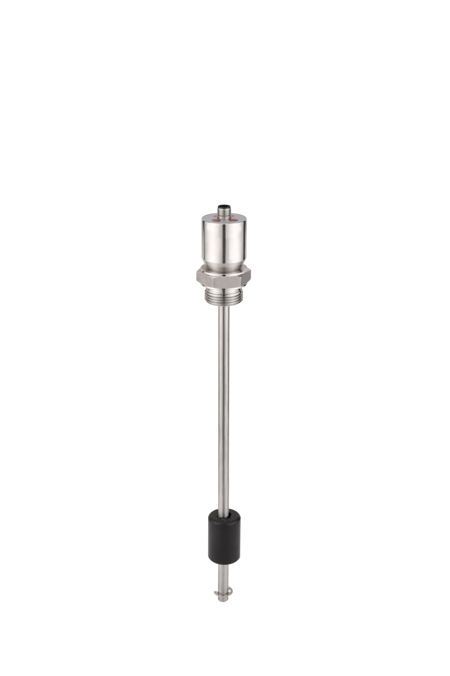
液位主推款
Liquid level main push model
01
电子式液位开关LF80A
液位开关通过内置电子探头对水位进行检测，再由芯片对检测到的信号进行处理，当判断到有水时，芯片输出高电平24V或5V等(PNP型），当判断到无水时，芯片输出0V。 The liquid level switch detects the water level through the built-in electronic probe, and then the chip processes the detected signal. When water is detected, the chip outputs high level 24V or 5V (PNP type), and when no water is detected, the chip outputs 0V..
浮一体式双表头显示液位温度开关传感器LF60E
02
高精度传感器进行温度测量，信号由后部处理电路处理后转换为标准工业电信号输出并显示。 High precision sensor for temperature measurement, signal processed by the rear processing circuit into standard industrial electrical signal output and display.

Slide 15
03
应用场景
Application scenarios

Slide 16
应用场景
Application scenarios
叶轮应用现场
流量开关应用现场
齿轮现场应用
液位应用现场

Slide 17
04
我们的优势
Our advantages

Slide 18
S
我们的优势
Our advantages
我们的优势
Our advantages
PAKU（帕库）产品现已广泛应用于不同的行业，在未来日益竞争的全球化市场，PAKU（帕库）将一如既往地以卓越的品质、合理 而具竞争力的价格，准时的交货期和完善的售后服务，服务于广大的海内外客户。
PAKU products have been widely used in different industries, in the future increasingly competitive global market, PAKU will continue to provide excellent quality, reasonable and competitive prices, timely delivery and perfect after-sales service to the vast number of customers at home and abroad

Slide 19
演示完毕
谢谢观看

